Slide 1



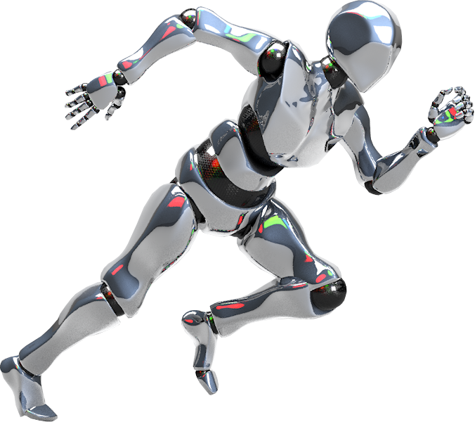

🏋️Gym Recommendation System using Machine Learning
A Personalized Fitness & Equipment Recommendation Platform
COURSE : ARTIFICIAL INTELLIGENCE
COURSE CODE : CSE 3812
DATE : //2025
Page
1

Slide 2




Our Team
AZMAIN ELAHI
SIBGATUL HASSEN
Iqramul Haider
011222289
0112230799
011183078
Page
2

Slide 3
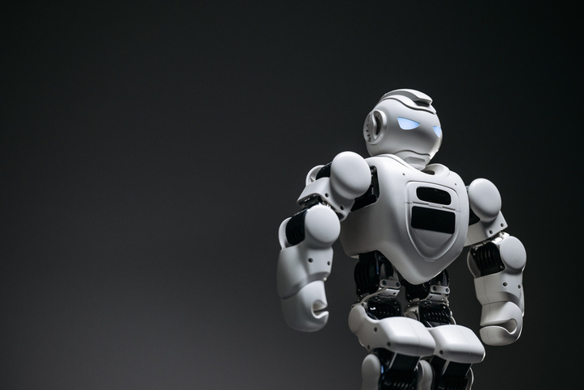
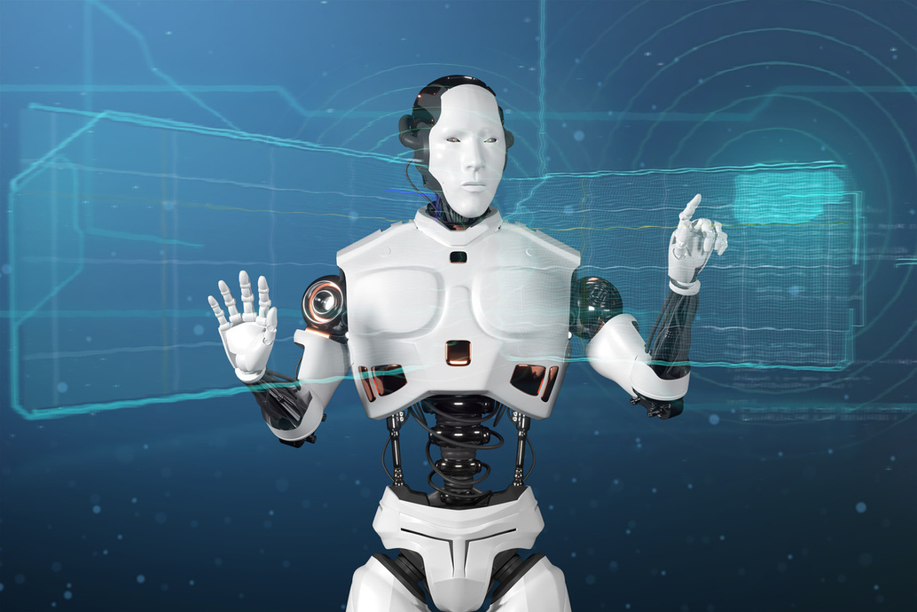
🧩 Slide 2: Problem Statement
Many people struggle with choosing the right exercises and equipment.
Fitness plans often ignore user-specific health conditions (like diabetes or hypertension).
A personalized recommendation system can improve effectiveness and safety.
Page
3

Slide 4
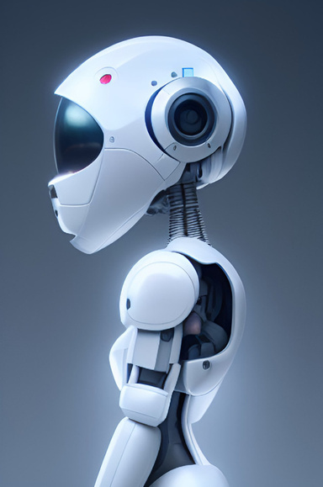
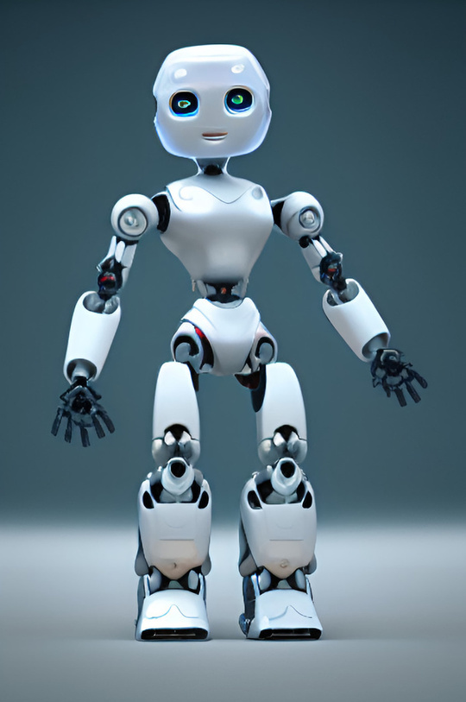
💡 Solution Overview
Our Solution:
✅ A machine learning-based system that recommends:
Best-suited exercises
Required equipment
Based on:
User's health metrics
Fitness goals & preferences
Delivered through an interactive Streamlit GUI.
Page
4

Slide 5
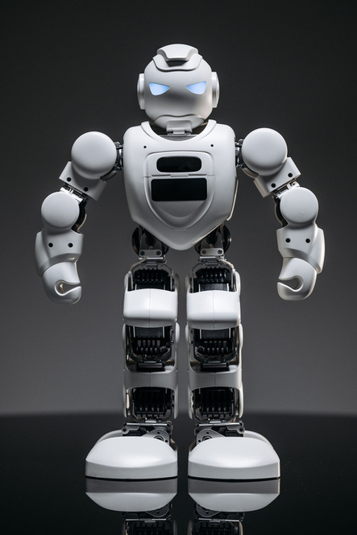
🗂️ Dataset Overview
Source: Custom
"gym recommendation.xlsx" file
Features Used:
Demographics: Sex, Age, Height, Weight
Medical: Hypertension, Diabetes
Preferences: Fitness Goal, Fitness Type
Targets: Exercises, Equipment
Page
5

Slide 6


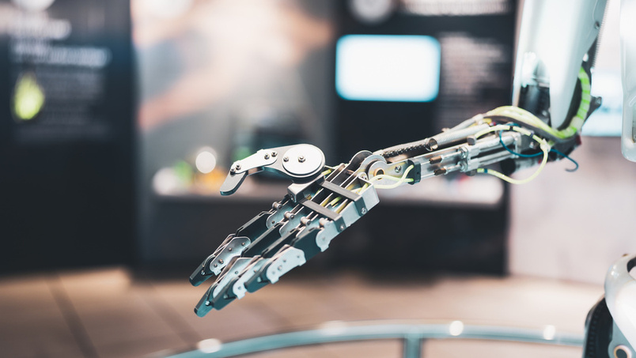
🛠️Data Preprocessing
Key preprocessing steps:
Label Encoding: Fitness Goal, Type, Level
Binary Mapping: Sex, Hypertension, Diabetes
Text Cleaning: Exercises and Equipment (replaced “and”, “or”, standardized formats)
Scaling: Age, Height, Weight using MinMaxScaler
Multi-label to single ID mapping for unique combinations
Page
6

Slide 7
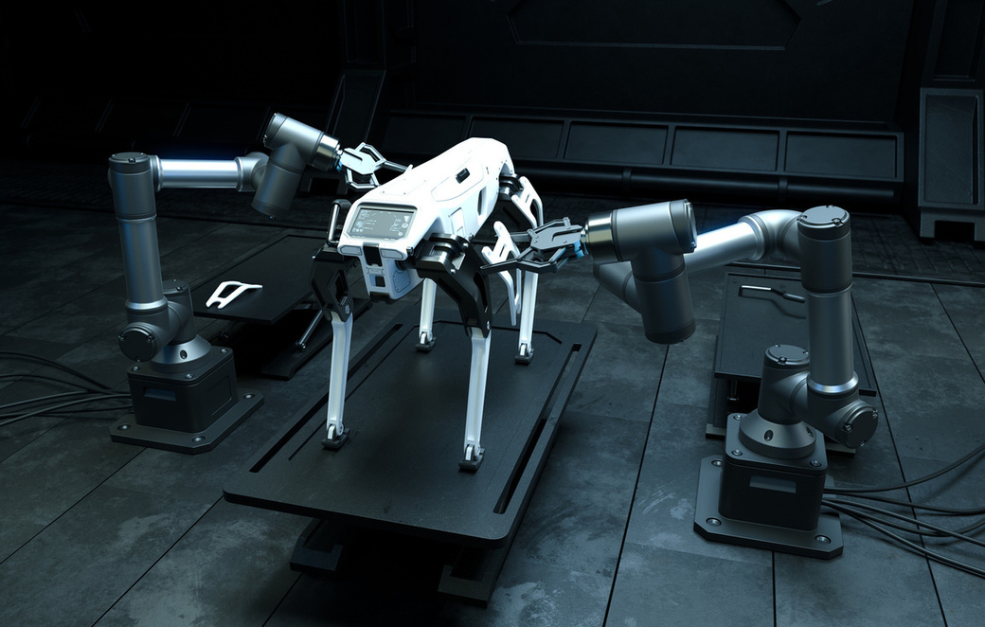
📊 Model Training
Model Used: MultiOutput Random Forest Classifier
Why MultiOutput? Because we predict both Exercises and Equipment together
Train-Test Split: 80-20
Evaluation: Accuracy & Classification Report for both outputs
Page
7

Slide 8




🧠 Model Performance
Sample Results (Accuracy may vary):
Exercises Prediction:
Accuracy: 99.62%
[Sample classes: squats,yoga,deadlifts etc.]
Equipment Prediction:
Accuracy: 96.05%
[Sample: Dumbbells, Yoga Mat, Resistance Bands, etc.]
page
8

Slide 9


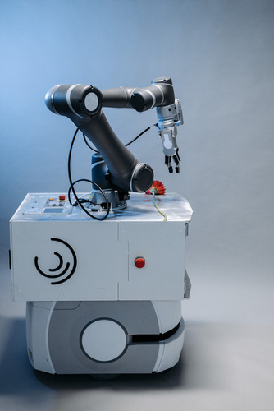
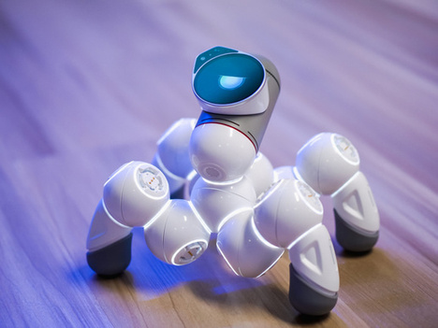
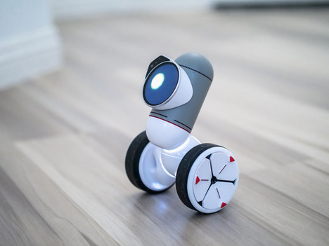
🖥️Streamlit Web App (GUI)
User Input Fields:
Gender, Age, Height, Weight
Hypertension, Diabetes
Fitness Goal & Fitness Type
Output:
Personalized Exercise & Equipment List
BMI Calculation & Health Category Advice
📌 Bonus: Visual recommendations & warnings based on BMI
Page
9

Slide 10


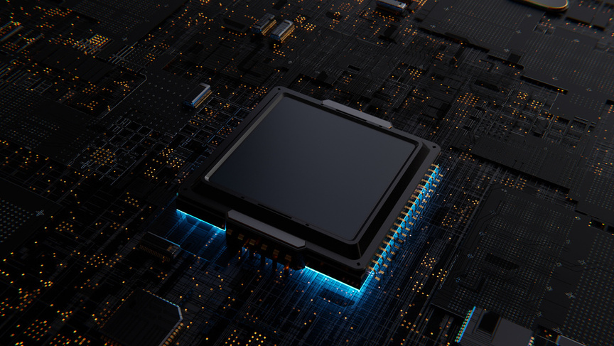

🔎Sample Prediction
Input Example:
Age: 30, Weight: 70kg, Height: 1.75m
Goal: Weight Loss, Type: Cardio
No Hypertension or Diabetes
Output:
Exercises: Running, Jump Rope
Equipment: Treadmill, Resistance Bands
BMI: 22.9 → Normal
Page
10

Slide 11

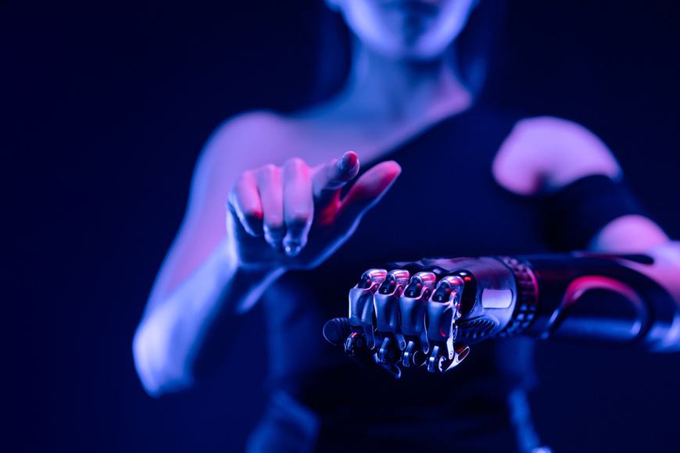
📦 Saved Artifacts
.pkl files for model and encoders
Encoded mappings for exercises and equipment
Preprocessed test dataset (Preprocessed_Data.xlsx)
🔐 Easily reload for fast inference and updates
Page
11

Slide 12


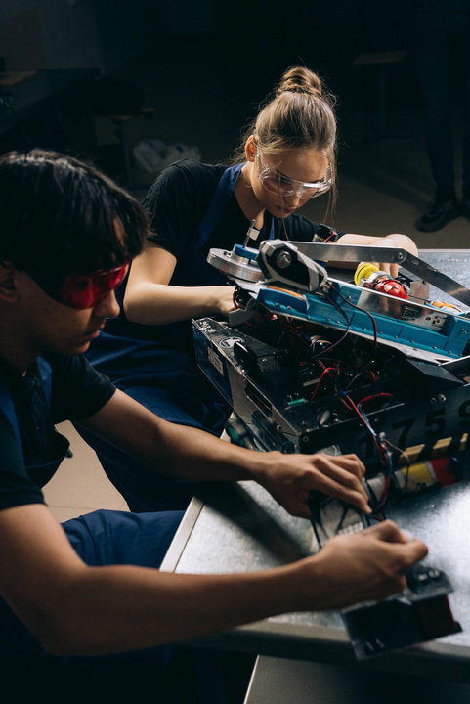

🚀Future Scope
Add Nutrition Plan based on BMI and goals
User login system for saved plans
Integration with wearable devices (e.g., Fitbit)
Voice-based assistant or chatbot support
Page
12

Slide 13
📚 Tools & Libraries
Python, Pandas, Scikit-learn
Streamlit for frontend
Joblib/Pickle for model persistence
Excel for raw data
Page
13

